Slide 1

MATC Smart Barrier Project
Ricardo Jacome
Michael Sweigard
Midwest Roadside Safety Facility
University of Nebraska-Lincoln
03/14/19

Slide 2
Outline
Project Background and Objective
Phase One
ABS Friction Testing
Phase Two (current work)
Goals
Path generation
Path following
Future Work

Slide 3
Project Background
53% fatal crashes related to road departures between 2014-2016 - FHWA
Drift-off road, overcorrection, failure to negotiate, avoidance maneuver
Notes:
Figure 1 Examples of ROR Crashes (images take from NHTSA’s NASS CDS)
Roll overs
Roadside fixed objects 1/3
Return to lane

Slide 4
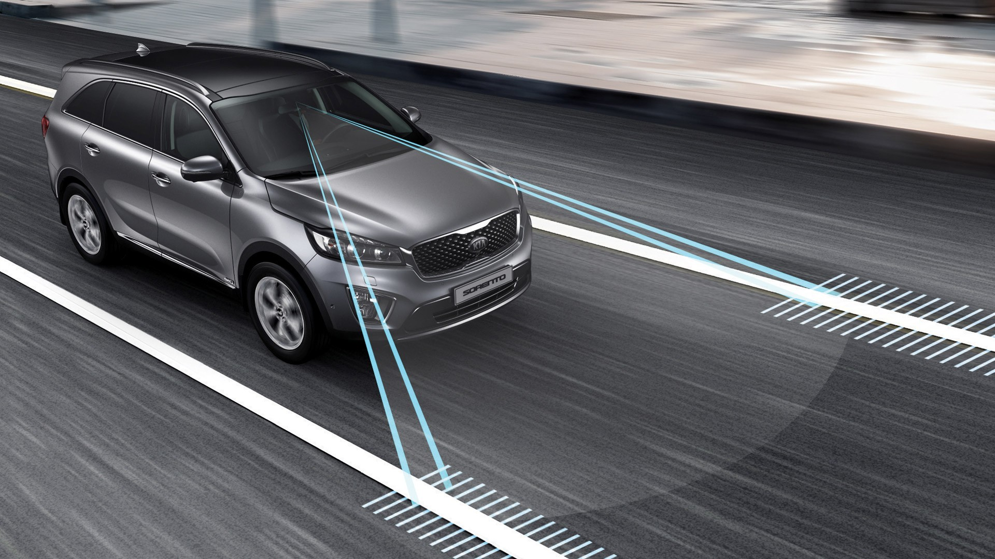
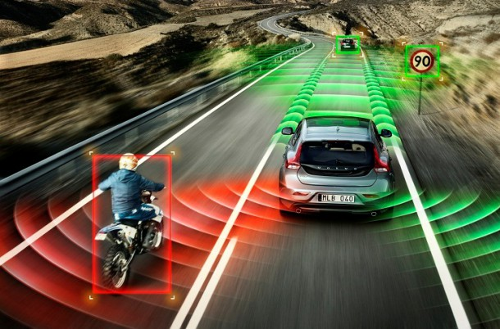
Project Background
Current advanced driver-assistance systems (ADAS) have considerable limitations

Slide 5
Project Goals
Develop a vehicle-to-roadside infrastructure (V2I) system to prevent roadside departures
Five phases
Literature Review
System Modeling
Model Verification/ Validation
Finalize System
Prototyping and Hardware
Year One
Year Two
Year Three
Year Four
Year Five

Slide 6
Literature Review Topics
Current Vehicle Market
Data Filters
Vehicle Control
Traffic Management
Cybersecurity

Slide 7
Abs testing & critical stability analysis

Slide 8
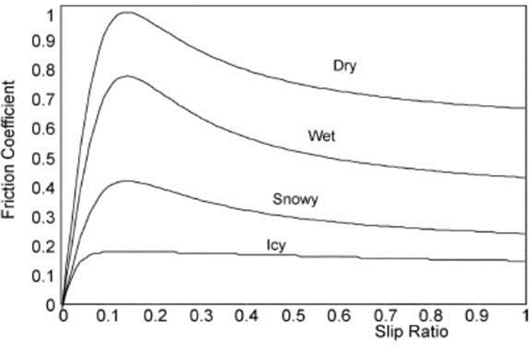
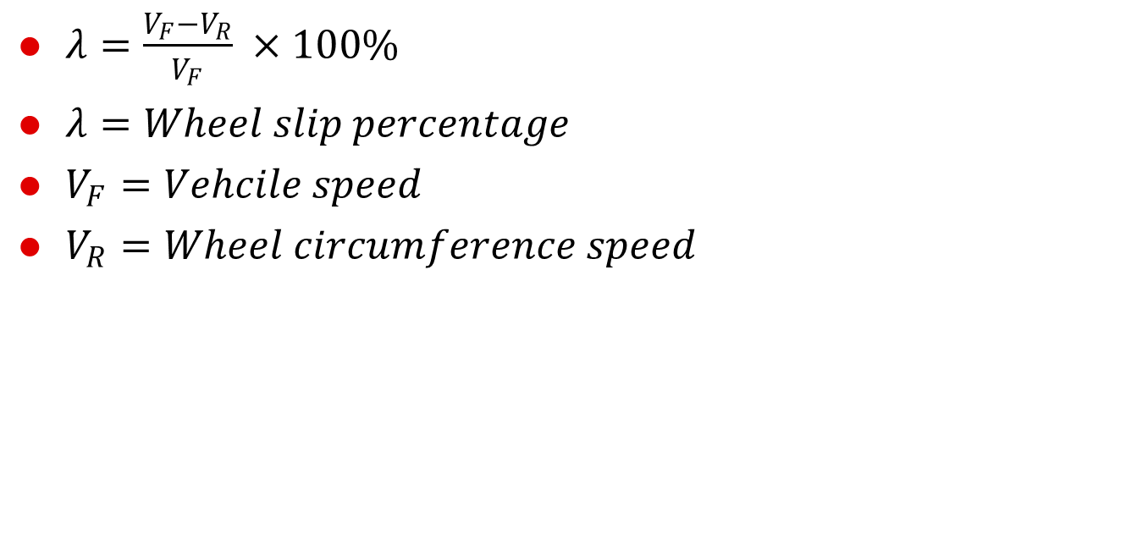
ABS Background
$λ=\frac{V_{F}−V_{R}}{V_{F}} ×100\%$
$λ=Wheel slip percentage$
$V_{F}=Vehcile speed$
$V_{R}=Wheel circumference speed$
Notes:
Junhui, L., and Jianqiang, Road Surface Condition Detection based on Road Surface Temperature and Solar Radiation, Volume 6, 2010 International Conference on Computer, Mechatronics, Control and Electronic Engineering, , IEEE, New York, New York, August 2010, pages 4-7.

Slide 9
ABS Friction Testing
Evaluate effectiveness of ABS on split-mu friction roads
Evaluated performance limits
Define emergency braking threshold
Develop vehicle braking model to estimate behavior for different surfaces
Simplified linear model
Average frictional values
Notes:
1) We need to determine when the vehicle must take action and/or warn the driver when a vehicle's path toward the roadside is critical.
2) A critical factor in vehicle safety and stability is the ability to brake.
3) The longer we can wait to apply brakes and start steering, without compromising safety, the less "false positive" corrections will be issued and drivers will be more likely to use system
4) A possible safety risk involves a vehicle partly on the paved road and partly on another surface
5) We conducted split-mu testing & baseline (benchmark) tests to evaluate what those effects are
6) Using those test results, we generated curves of effective, average friction & ramp-up times for different surfaces per wheel
7) Results were used to generate approximation models for computer simulation purposes

Slide 10
Braking Model
Develop vehicle braking model to estimate behavior for different surfaces
Simplified linear model
Average frictional values
Notes:
1) We need to determine when the vehicle must take action and/or warn the driver when a vehicle's path toward the roadside is critical.
2) A critical factor in vehicle safety and stability is the ability to brake.
3) The longer we can wait to apply brakes and start steering, without compromising safety, the less "false positive" corrections will be issued and drivers will be more likely to use system
4) A possible safety risk involves a vehicle partly on the paved road and partly on another surface
5) We conducted split-mu testing & baseline (benchmark) tests to evaluate what those effects are
6) Using those test results, we generated curves of effective, average friction & ramp-up times for different surfaces per wheel
7) Results were used to generate approximation models for computer simulation purposes

Slide 11
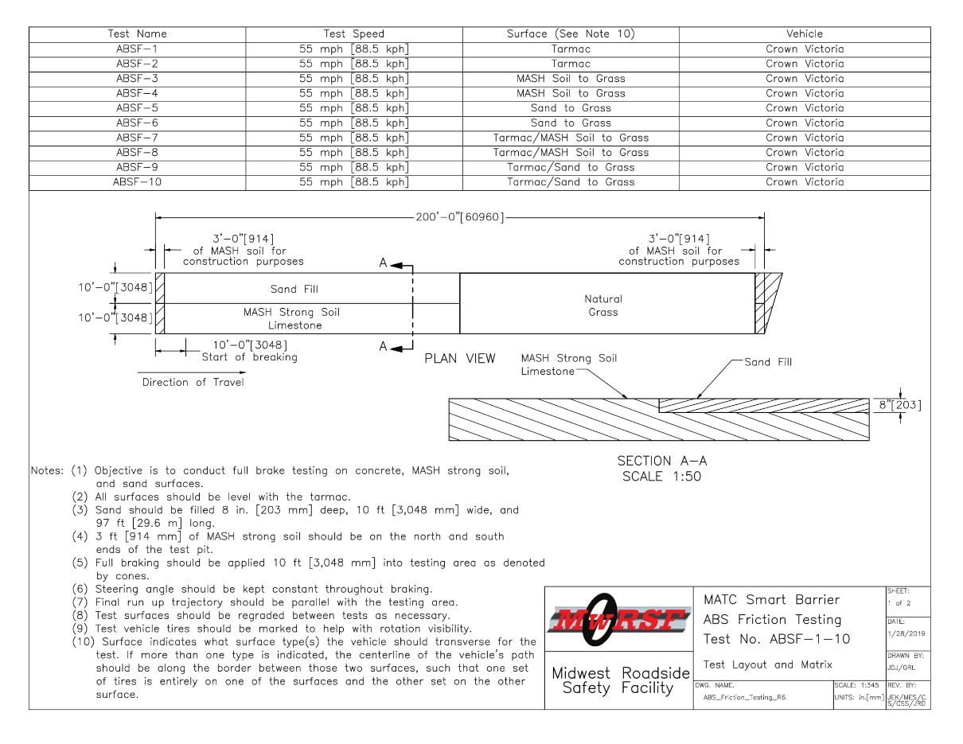
ABS Friction Testing

Slide 12
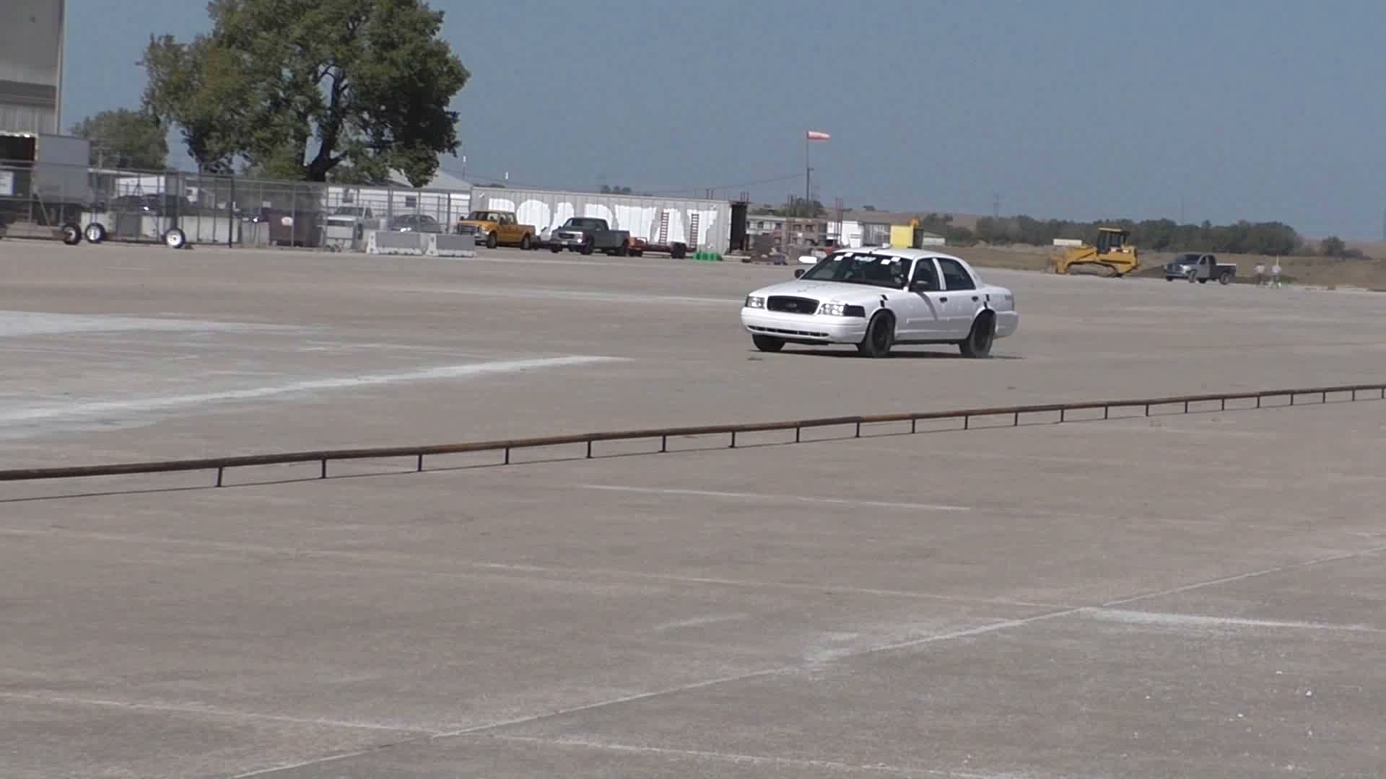
ABS Friction Testing
Notes:
ABSF-5 sand to grass

Slide 13
ABS Friction Results
 | ABSF-1 (concrete) | ABSF-2 (concrete) | ABSF-3 (gravel) | ABSF-3 (grass) | ABSF-4 (gravel) | ABSF-4 (grass) | ABSF-5 (sand) | ABSF-5 (grass) | ABSF-6 (sand) | ABSF-6 (grass)
Total Braking Time (sec) | 3.0 | 3.2 | 5.4 |  | 5.6 |  | 5.7 |  | 5.2
Total Braking Distance (ft) | 127 | 147 | 227 |  | 214 |  | 206 |  | 230

Slide 14
ABS Friction Results
ABSF-7 (split-mu concrete/ gravel) | ABSF-7 (split-mu concrete/ grass) | ABSF-8 (split-mu concrete/ gravel) | ABSF-8 (split-mu concrete/ grass) | ABSF-9 (split-mu concrete/ sand) | ABSF-9 (split-mu concrete/ grass) | ABSF-10 (split-mu concrete/ sand) | ABSF-10 (split-mu concrete/ grass)
4.4 |  | 4.1 |  | 4.9 |  | 4.3
197 |  | 173 |  | 221 |  | 197

Slide 15
ABS Friction Results

Slide 16
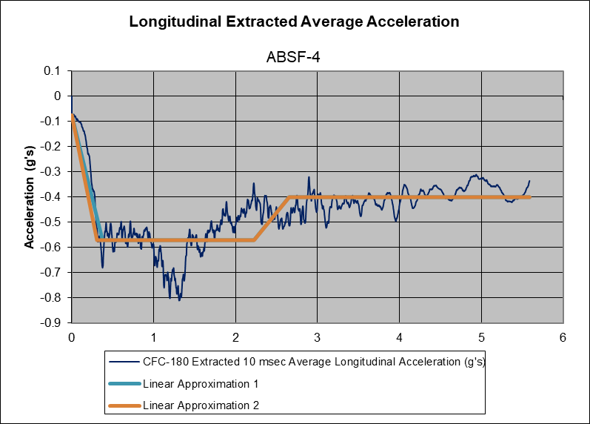
 | Ramp Up Slope (g's/s) | Ramp Up time | Max/Min Coefficient of Friction | Average Coefficient of Friction | Transition Time (sec)
ABSF-4 (gravel) | 1.61 | 0.31 | 0.81/0.34 | 0.57 | N/A
ABSF-4 (grass) | N/A | N/A | 0.52/0.31 | 0.40 | 0.43
Notes:
Explain Breaking Event
Multiple methods for determining slope: Fixed ends and weighted average
Average value for friction surface
Transition based on integrated stopping distance

Slide 17
Development of Desired Path Generation Techniques

Slide 18
Phase II: Path Generation
Motivation
For vehicle to remain on road, need critical parameters
Vehicle location with respect to road (lane) edges
Road path vector
Vehicle velocity vector
Orientation (heading) angle
Current methods of AV requires vehicles to determine location & guidance autonomously

Slide 19
Phase II: Path Generation
GPS Application for Guidance
Conventional GPS accuracy: +/- 7 to 10 ft
Update frequency: 10 Hz
Increased precision requires network of connected base stations, extensive data
Not available in all locations (e.g., mountains)
New Approach
Rethink guidance on local + global scale using long-range fixed roadside reference network

Slide 20
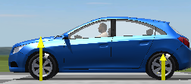
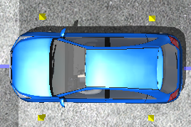
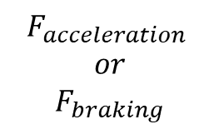
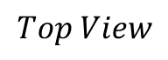
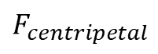
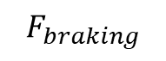
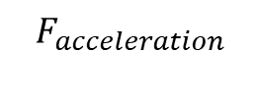
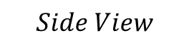
Background: Vehicle Dynamics
$$Side View$$
$$F_{acceleration}$$
Forces on Straight Line Motion
$$F_{braking}$$
$$Top View$$
$$F_{acceleration}$$
$$or$$
$$F_{braking}$$
Forces on Curvilinear Motion
$$F_{centripetal}$$

Slide 21
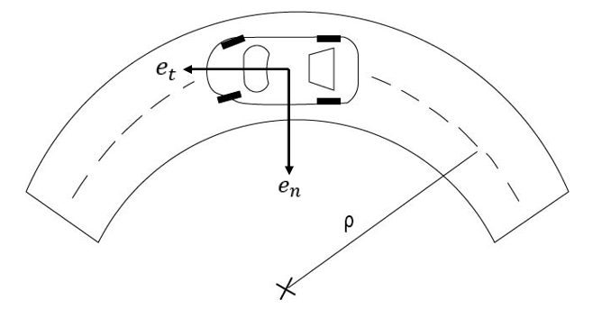
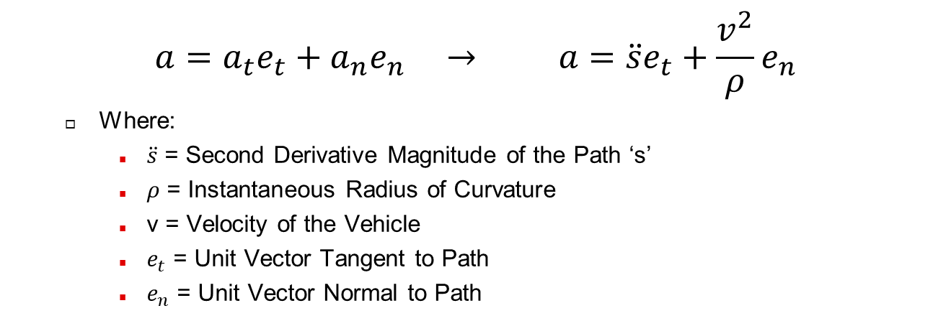
Normal-Tangential Accelerations
Vehicle Centerline
$$a=a_{t}e_{t}+a_{n}e_{n} → a=\ddot{s}e_{t}+\frac{v^{2}}{ρ}e_{n}$$
Where:
$\ddot{s}$ = Second Derivative Magnitude of the Path ‘s’
$ρ$ = Instantaneous Radius of Curvature
v = Velocity of the Vehicle
$e_{t}$ = Unit Vector Tangent to Path
$e_{n}$ = Unit Vector Normal to Path

Slide 22
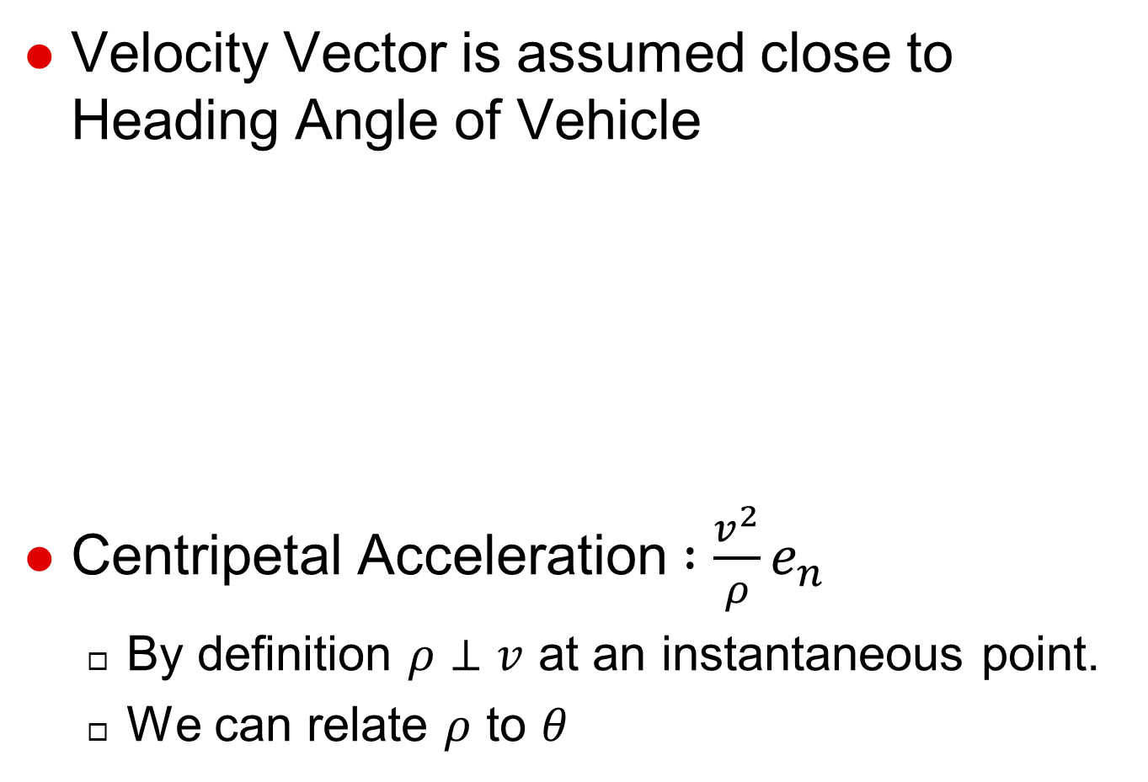

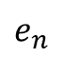
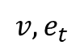
Road Slicing Background
Velocity Vector is assumed close to Heading Angle of Vehicle
Centripetal Acceleration $:\frac{v^{2}}{ρ}e_{n}$
By definition $ρ⊥v$ at an instantaneous point.
We can relate $ρ$ to $θ$
Y
Y
$${v, e}_{t}$$
$$θ$$
X
$$e_{n}$$
X

Slide 23
Road Slicing Technique
Slice the Road in small sections and find a curvature of each slice
Scanning the road with sensors such as lidar
Aerial/satellite map & custom plots
Find velocity vector perpendicular to road slice
Generate map of velocity vector, magnitude based on physical position

Slide 24
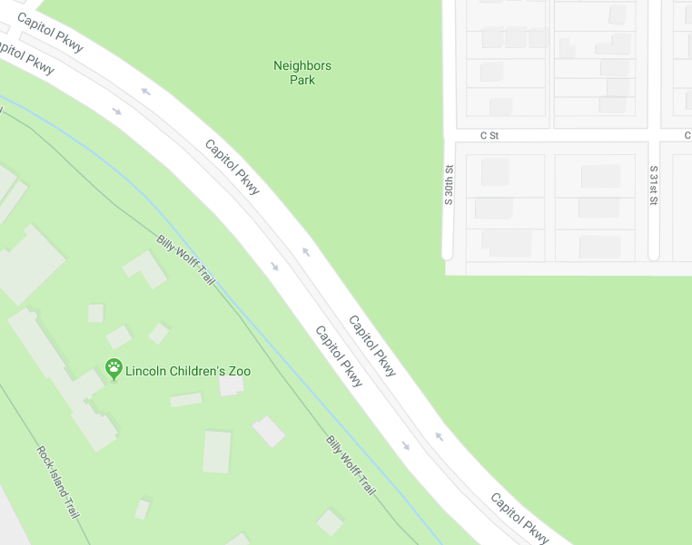

Road Sampling Example

Slide 25
Road Slicing

Slide 26
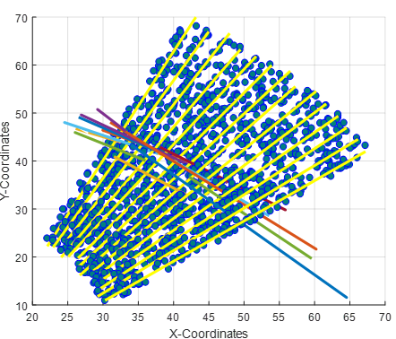
Multiple Sections of Slices

Slide 27
Velocity Vector Angle
Approach is limited to Directions Only as of now
Research is being done on how to relate Ackerman Steering Angle and Road Slicing Technique

Slide 28
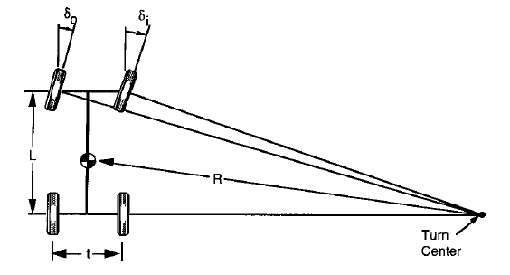
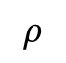

Ackerman Steering
$$ρ$$
At low speeds, this geometric relationship holds true:
$$δ=\frac{L}{ρ}$$
For Ackerman Steering, it is assumed that the value is an average of both wheels together.
Notes:
Images from Fundamentals of Vehicle Dynamics – Thomas D. Gillespie

Slide 29
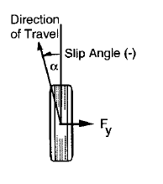
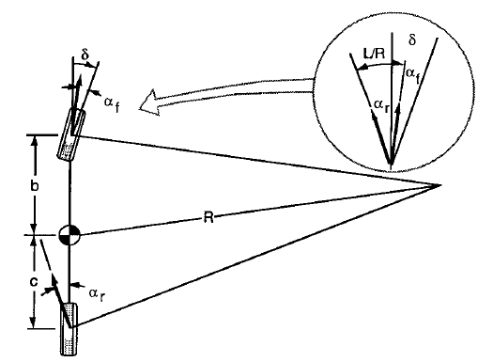
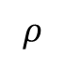
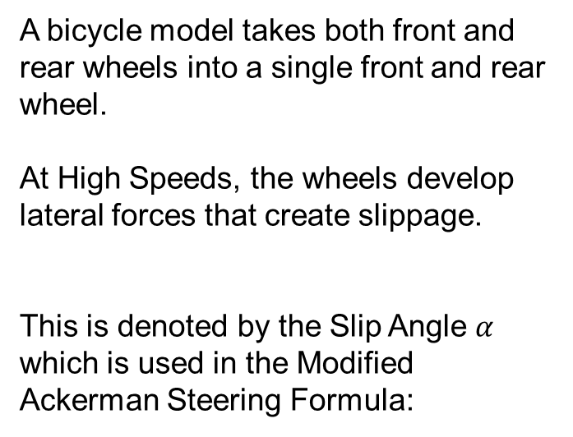
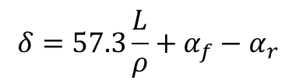
Modified Ackerman Steering
A bicycle model takes both front and rear wheels into a single front and rear wheel.
At High Speeds, the wheels develop lateral forces that create slippage.
This is denoted by the Slip Angle $α$ which is used in the Modified Ackerman Steering Formula:
$$ρ$$
$$δ=57.3\frac{L}{ρ}+α_{f}−α_{r}$$
Notes:
Images from Fundamentals of Vehicle Dynamics – Thomas D. Gillespie

Slide 30
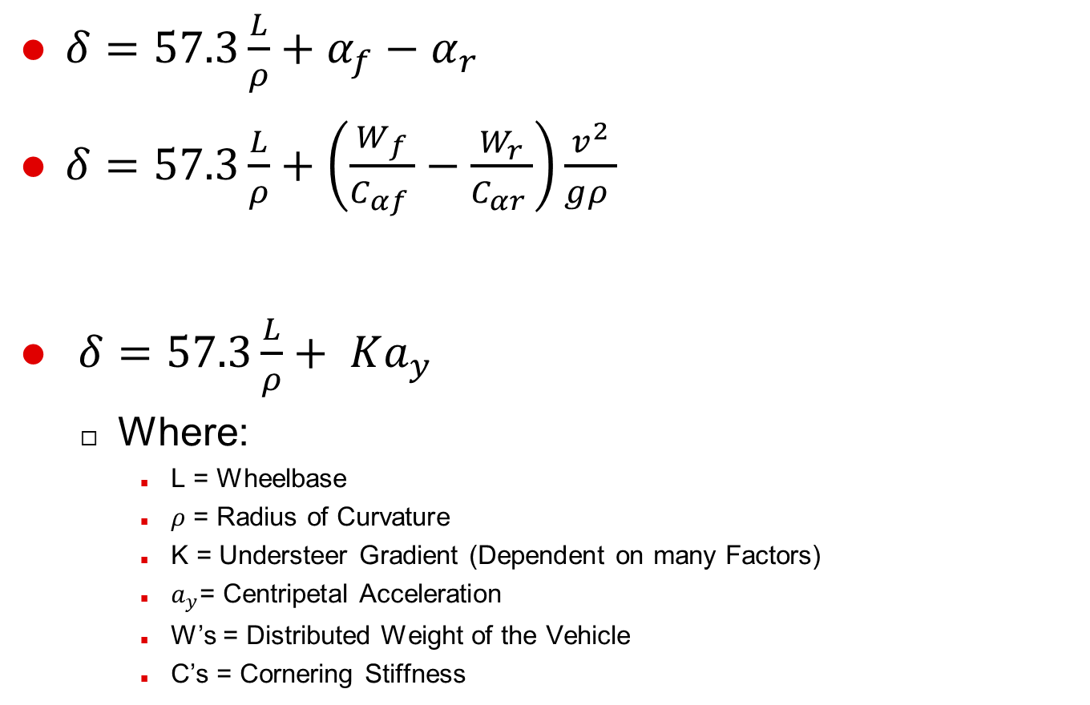

Steering Gradient Factors
$δ=57.3\frac{L}{ρ}+α_{f}−α_{r}$
$δ=57.3\frac{L}{ρ}+\left(\frac{W_{f}}{C_{αf }}−\frac{W_{r}}{C_{αr }}\right)\frac{v^{2}}{gρ }$
$δ=57.3\frac{L}{ρ}+ Ka_{y}$
Where:
L = Wheelbase
$ρ$ = Radius of Curvature
K = Understeer Gradient (Dependent on many Factors)
$a_{y}$= Centripetal Acceleration
W’s = Distributed Weight of the Vehicle
C’s = Cornering Stiffness
$$K{ a}_{y}$$
Notes:
L = Wheelbase of Vehicle
V = The velocity of the vehicle
Rho = Instantaneous Radius of Curvature
Wf = Distributed Front Weight of Vehicle
Wr = Distributed Rear Weight of Vehicle
Caf = Cornering Stiffness of the Front Tires
Car = Cornering Stiffness of the Rear Tires
G = Gravitational Acceleration Constant

Slide 31
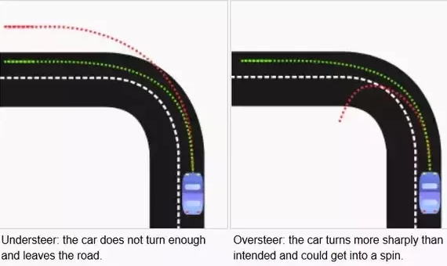
Steering Gradient Behavior
$K>0 →Understeer$ $K<0 →Oversteer$

Slide 32
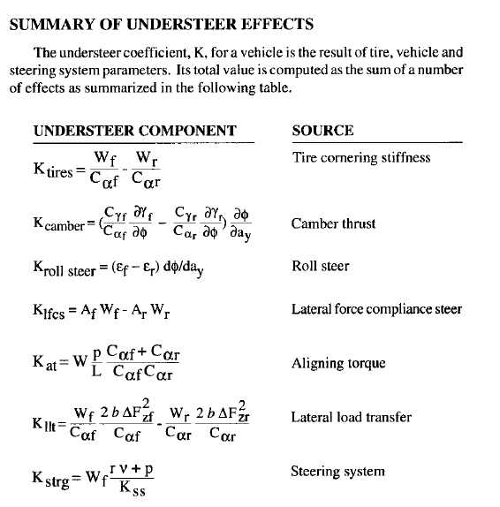
Hidden Slide

Slide 33
Develop Model of Road Paths

Slide 34
Trajectory Control
Goal:
Use vehicle velocity vector angle to safety traverse the roadway
Simplified vehicle model
PID Control

Slide 35
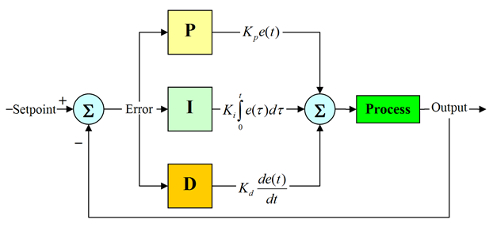
PID Control

Slide 36
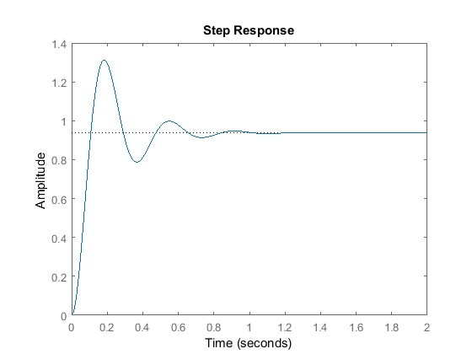
PID Control
Notes:
Kp works to get to the desired value as fast as possible but can overshoot due to momentum
Kd applies correction if error is small but slope is big, dampens system, reduces overshoot
Ki eliminates stead state error

Slide 37
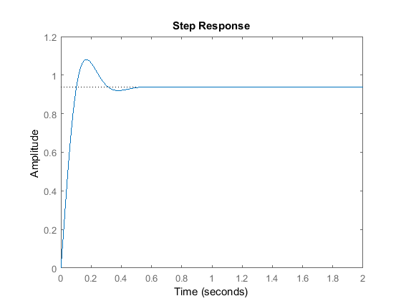
PID Control
Notes:
Kd applies correction if error is small but slope is big, dampens system, reduces overshoot

Slide 38
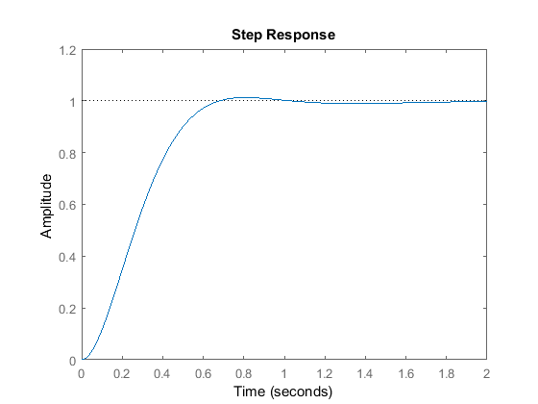
PID Control
Notes:
Ki eliminates stead state error

Slide 39
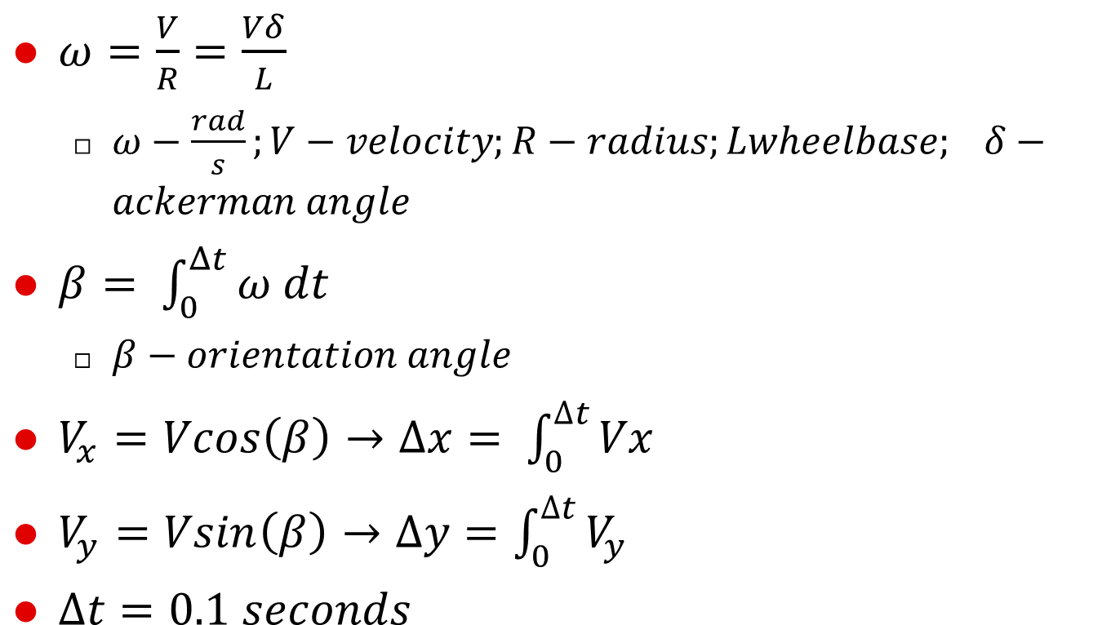
Model Base Equations
$ω=\frac{V}{R}=\frac{Vδ}{L}$
$ω−\frac{rad}{s};V−velocity;R−radius;Lwheelbase; δ−ackerman angle$
$β= \int_{0}^{Δt}{ω dt}$
$β−orientation angle$
$V_{x}=Vcos\left(β\right)→∆x= \int_{0}^{∆t}{Vx}$
$V_{y}=Vsin\left(β\right)→∆y=\int_{0}^{∆t}{V_{y}}$
$Δt=0.1 seconds$
Notes:
Time step of 0.1 seconds

Slide 40
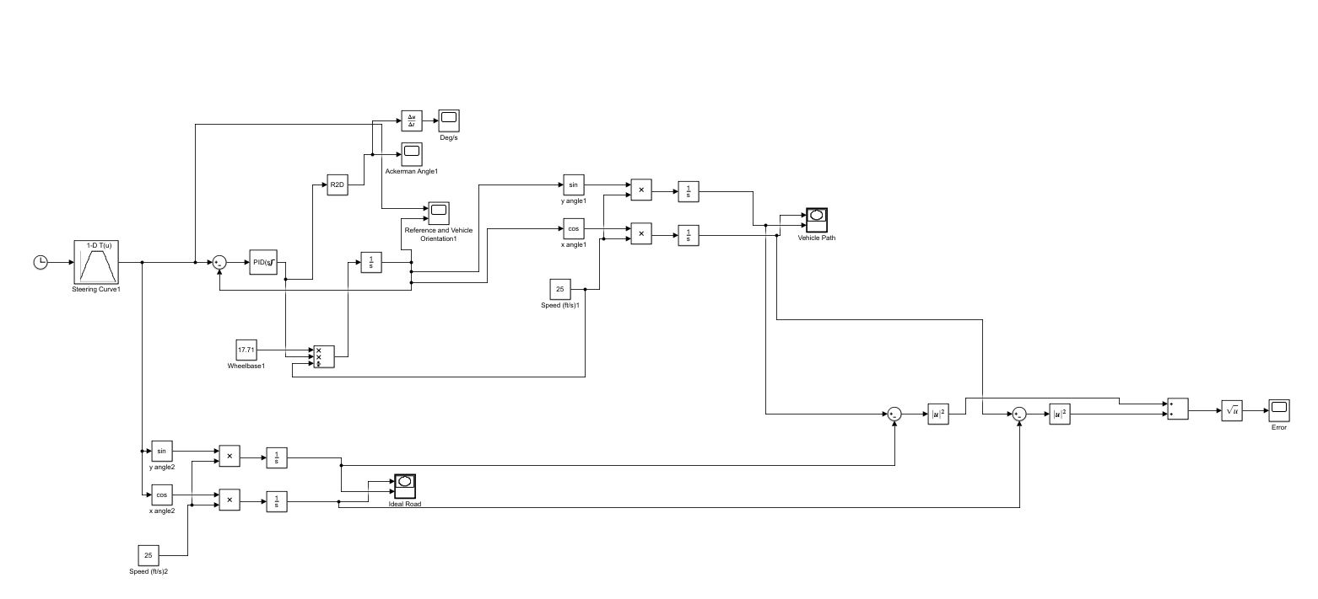
Path Following Model

Slide 41
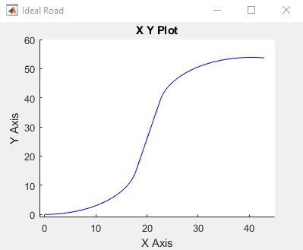
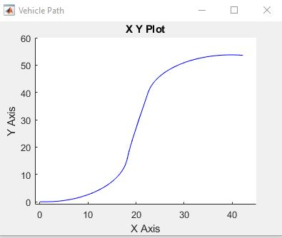
Model Performance

Slide 42
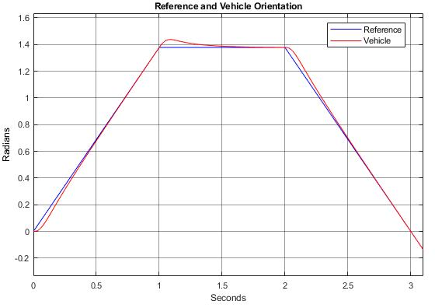
Model Performance

Slide 43
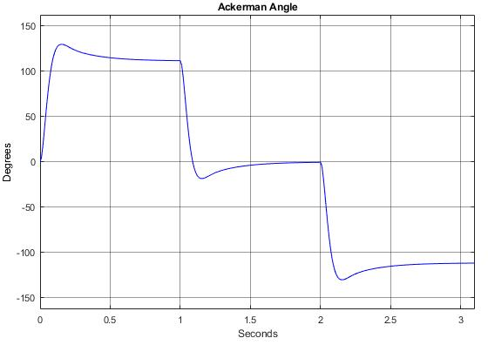
Model Performance

Slide 44
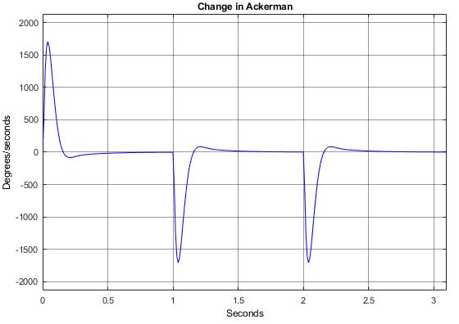
Model Performance

Slide 45
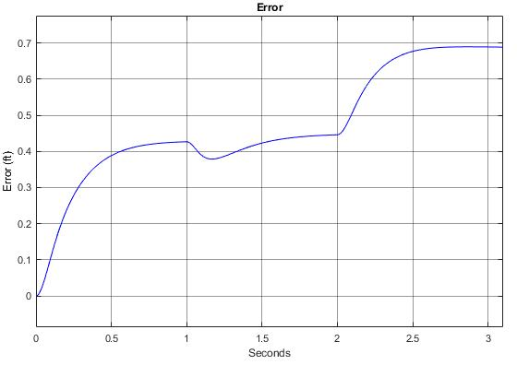
Model Performance

Slide 46
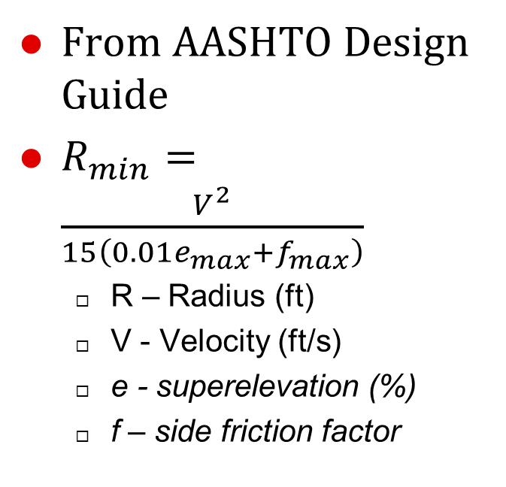
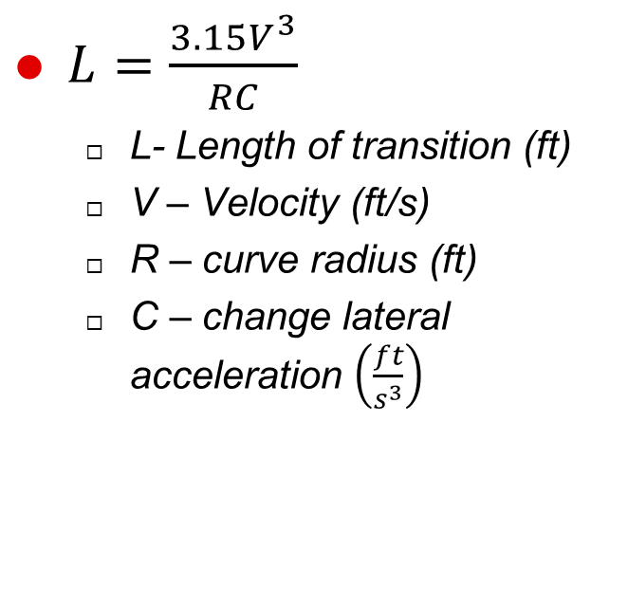
Road Generation
From AASHTO Design Guide
$R_{min}=\frac{V^{2}}{15\left(0.01e_{max}+f_{max}\right)}$
R – Radius (ft)
V - Velocity (ft/s)
e - superelevation (%)
f – side friction factor
$L=\frac{3.15V^{3}}{RC}$
L- Length of transition (ft)
V – Velocity (ft/s)
R – curve radius (ft)
C – change lateral acceleration $\left(\frac{ft}{s^{3}}\right)$
Notes:
Chose values that would minimize the radius for a more dynamic path

Slide 47
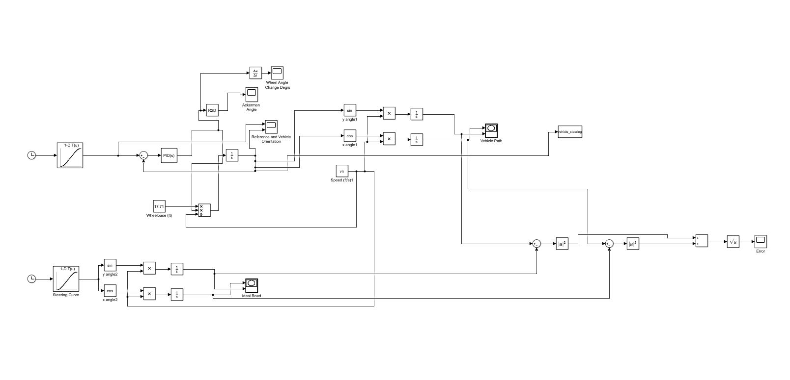
Path Following Model

Slide 48
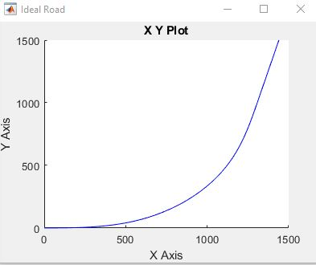
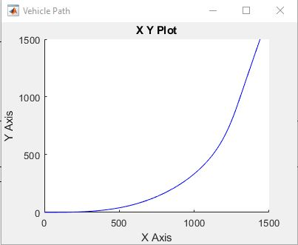
Model Performance

Slide 49
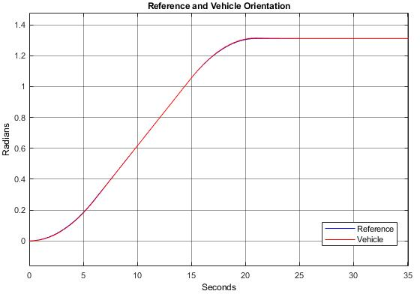
Model Performance

Slide 50

Model Performance

Slide 51

Model Performance

Slide 52

Model Performance

Slide 53
Future Work
Path Generation
Path generation optimization
Develop relationships for road curvature
Obtain heading angles
Path Following
Minimization of data points
PID optimization
Correction for error accumulation
Add in advanced vehicle model
Triangulation method
Notes:
Understeer gradient, maximum friction level

